Slide 1

Stock Market Analysis

Slide 2

Introduction
Thestockmarket is one of the most dynamic and data-driven sectors in the world. Every
second, millions of transactions occur, influencing stock prices, volumes, and market capitalization. Investors, traders, and financial analysts rely heavily on accurate and timely data to make informed decisions. However, with the ever-growing size of financial data, it becomes difficult to extract meaningful insights using traditional methods like spreadsheets or static reports. To address this challenge, modern Business Intelligence (BI) tools like Power BI play a crucial role in converting raw data into interactive dashboards and reports. A well- designed dashboard not only saves time but also enables users to identify trends, risks, and opportunities at a glance.
This project, Stock Market Analysis Dashboard, leverages Power BI to visualize stock data in an interactive and meaningful way. The dashboard presents stock prices, trading volumes, sectoral performance, and company-level comparisons, providing stakeholders with a powerful tool to monitor performance, forecast trends, and support investment decisions.

Slide 3
Problem Statement
The stock market generates massive volumes of complex data every day. This data includes price fluctuations, trading volumes, market indices, and sectoral shifts. For investors, analysts, and financial institutions, the main challenge lies not in accessing the data but in understanding and interpreting it effectively. Traditional methods such as tabular reports and static charts fail to provide the flexibility and interactivity required for modern financial analysis. Without an effective visualization system: Identifying trends and anomalies in stock prices becomes time-consuming. Comparing performance across different companies or sectors is difficult. Key insights like highest-performing stocks, average returns, and volatility remain hidden. Decision-making for investment strategies becomes slow and error-prone. Thus, there is a pressing need for a consolidated, interactive, and user-friendly dashboard that brings together all stock market data in a single platform. Such a dashboard should help users analyze time-based patterns, sector comparisons, and KPIs, thereby enabling data-driven decisions rather than relying on guesswork.

Slide 4
Objectives
1.Dashboard Development
To design and develop an interactive stock market analysis dashboard using Power BI. To provide a single consolidated platform for monitoring stock performance. 2. Data Analysis & Insights To analyze stock price trends (daily, monthly, yearly) and identify patterns. To study trading volumes and detect unusual spikes or anomalies. To evaluate sector-wise performance for better investment strategies. To calculate and visualize key indicators such as moving averages, percentage change, and volatility. 3. Decision Support To enable investors and analysts to make data-driven decisions instead of relying only on instincts.

Slide 5
To highlight top-performing and underperforming stocks at a glance.
4. User Interactivity To add filters and slicers (by company, sector, and time period) for personalized analysis. To allow drill-down analysis from overall market view
view.
→ sector view → company
5. Visualization & Storytelling To present key KPIs (stock price, % change, average volume, market cap) in card visuals. To use line charts, candlestick charts, treemaps, and bar charts for easy interpretation. To add forecasting visuals for predicting future stock behavior.

Slide 6
6. Business Value
To simplify complex financial data into actionable insights. To save time in analysis through automated reports rather than manual calculations. To build a tool that can be extended for real-time stock market integration in the future.

Slide 7
Data Collection Process
Source: Public stock market datasets (NSE/BSE/Yahoo Finance/CSV exports). Data Attributes: Date, Open Price, Close Price, High, Low, Volume, Sector, Company. Cleaning & Transformation:
Removed duplicates and missing values. Converted dates into proper format for time-series analysis.
Calculated new measures (Daily Returns,%Change,MovingAverages).
Loading: Imported the dataset into Power BI for analysis and dashboard creation.

Slide 8
Data Processing and Cleaning
Handled missing values using forward fill and mean substitution.
Removed duplicates and irrelevant columns.
Detected and treated outliers in stock price data.
Standardized date formats and normalized numerical features.
Created new features (moving averages, daily returns) for better forecasting.

Slide 9
Exploratory Data Analysis (EDA)
Analyzed stock price trends (Open, Close, High, Low).
Identified seasonality and patterns in time series.
Plotted moving averages to observe long-term trends.
Studied correlation between price and volume.
Used ACF/PACF plots to detect autocorrelations.

Slide 10

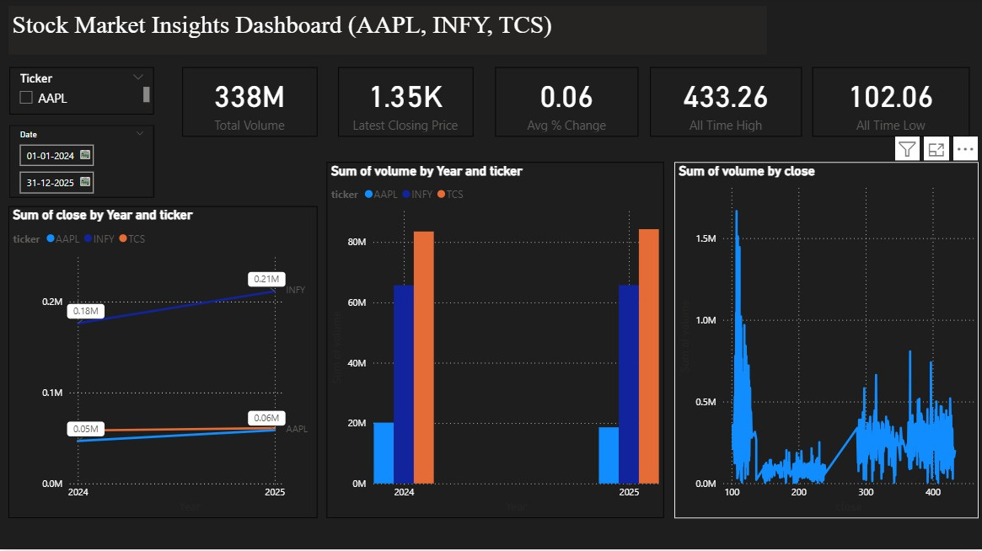
Dashboard

Slide 11
Model Development (ARIMA, SARIMA, Prophet, LSTM)
ImplementedARIMA forlineartimeseries forecasting.
Applied SARIMA to capture seasonality effects.
Used Prophet for trend and holiday-based forecasting.
Built LSTM deep learning model to capture non-linear patterns.
Trained and validated models using historical stock data.
Performed hyperparameter tuning to improve model accuracy.
Compared models to identify the best-performing approach.

Slide 12
Model Evaluation & Comparison
Evaluated models using error metrics: RMSE, MAE, MAPE.
Compared ARIMA, SARIMA, Prophet, and LSTM performance.
ARIMA/SARIMA performed well for short-term linear patterns.
Prophet handled trend + seasonality effectively.
LSTM achieved the lowest error by capturing complex non-linear trends.
Final model selection based on accuracy, stability, and forecasting ability.

Slide 13
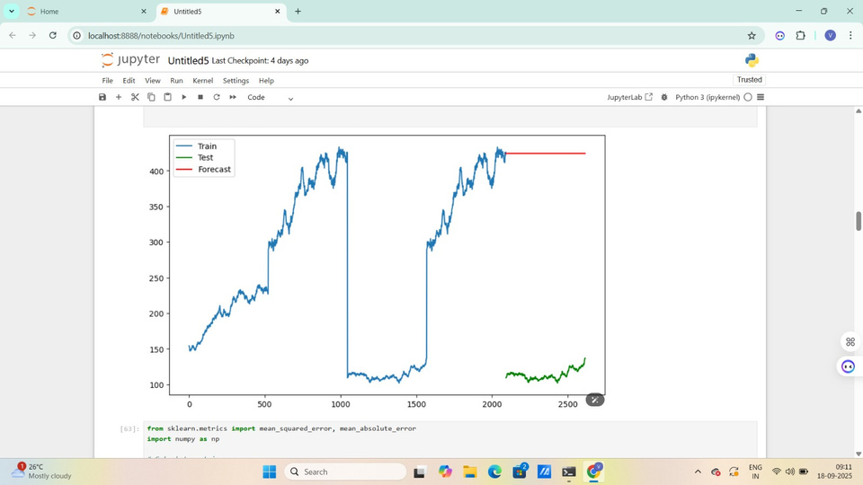
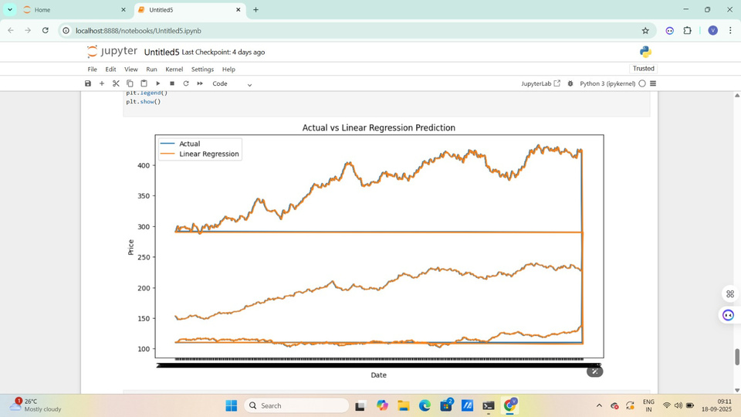
Screenshot

Slide 14
Final Results & Insights
Forecasted future stock prices with multiple models.
LSTM achieved the highest accuracy and lowest error (RMSE/MAE).
Traditional models (ARIMA, SARIMA, Prophet) worked well for short- term and seasonal patterns.
Predicted trends aligned closely with actual market behavior.
Analysis provides valuable insights for investors and decision-makers.
Demonstrates the importance of combining statistical + deep learning approaches in stock forecasting.

Slide 15
Conclusion
Successfully analyzedstockmarketdata using statistical and deep learning models.
Data preprocessing and EDA revealed key trends, patterns, and correlations.
ARIMA, SARIMA, and Prophet captured linear and seasonal behaviors.
LSTM outperformed traditional models by handling non-linear dependencies.
Insights from the study can support better investment and forecasting decisions.
Provides a foundation for future improvements like sentiment analysis and real-time prediction.

